Slide 1
LGT 2106/LGT2B02 Principles of Operations Management
Lecture 4
Plant Location & Facility Layout

Slide 2
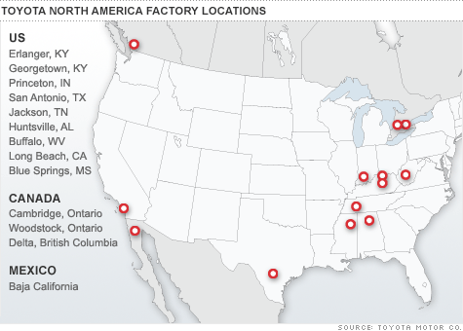
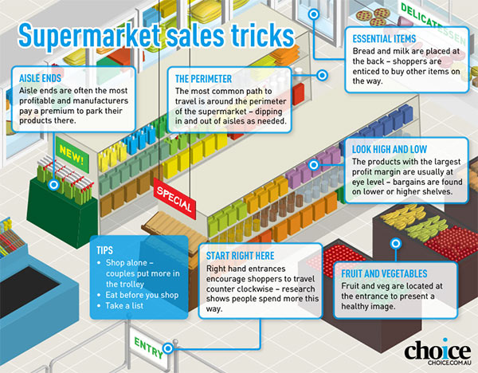
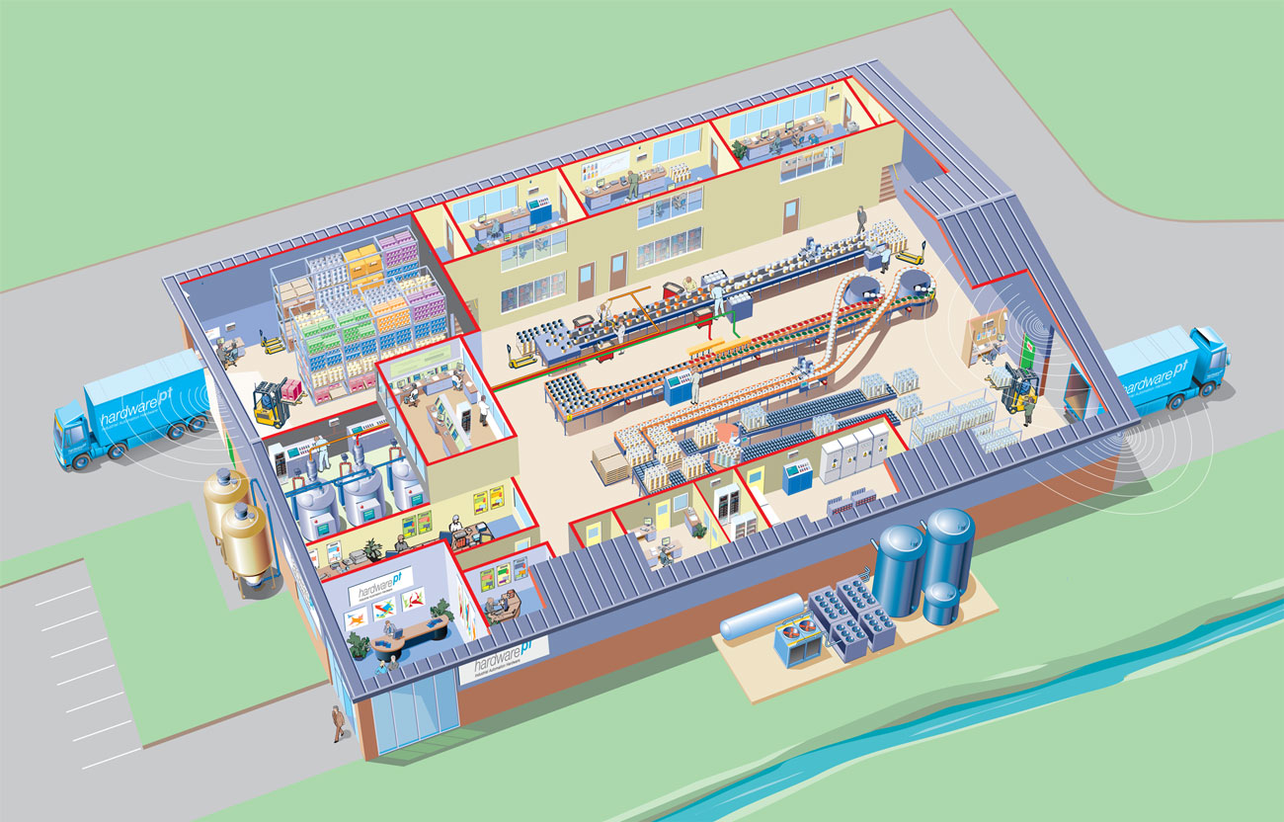
location
Service layout
Facility layout

Slide 3
Learning Outcomes
Lecture outline I
Identify the various factors, both quantitative and qualitative, that should be taken into consideration when selecting a location for a manufacturing or service organization.
Evaluate alternative site locations by different criteria.
Know different types of facility layouts that can be used in designing manufacturing and service operations.
References: Jacobs & Chase, 15th ed, Chapters 8, 15.

Slide 4



Where to locate your factory?

Slide 5
Locating Manufacturing Facilities
Products that decrease in weight and volume during manufacturing tend to be located near the sources of raw materials.
Products that increase in weight and volume during manufacturing tend to be located near the consumers.
One site’s cost disadvantage such as transportation may be offset by a cost savings advantage specific to the site such as low labor costs.
A location analysis should consider both qualitative and quantitative factors

Slide 6
Qualitative Location Factors
Local Infrastructure
Institutional (e.g., reliable electrical power grid)
Transportational (e.g., railway systems)
Worker Education and Skills
Education and skills of local workers.
Product Content Requirements
The minimum percentage of product that must be produced in a country in order for the product to be sold in that country.
Political/Economic Stability

Slide 7
Product content requirements
“Any new smartphone sold in Indonesia this year should have at least 30 percent of its total value in local content, consisting of either components or software, or both.”
“Samsung Indonesia vice president Lee Khang Hyun said his company‘s manufacturing plant and research and development center in Cikarang, West Java, helped it clear local content requirements.”
“Apple, which missed a chance to sell its iPhone 6 in Indonesia last year, has lost out to rival Samsung in securing Southeast Asia's largest smartphone market.”
Source: Jakarta Globe, 19 Jan 2017
Notes:
http://jakartaglobe.id/business/apple-considering-three-locations-in-indonesia-for-its-rd-centers/

Slide 8
Quantitative Location Factors
Labor Costs
Labor costs vary dramatically, depending on location. Cheap labor often lacks needed education and skills.
Distribution Costs
Distance and the time required to deliver products can offset lower location costs.
Facility Costs
Special economic zones (SEZ)
Duty-free areas established to attract foreign investment in the form of manufacturing facilities.

Slide 9
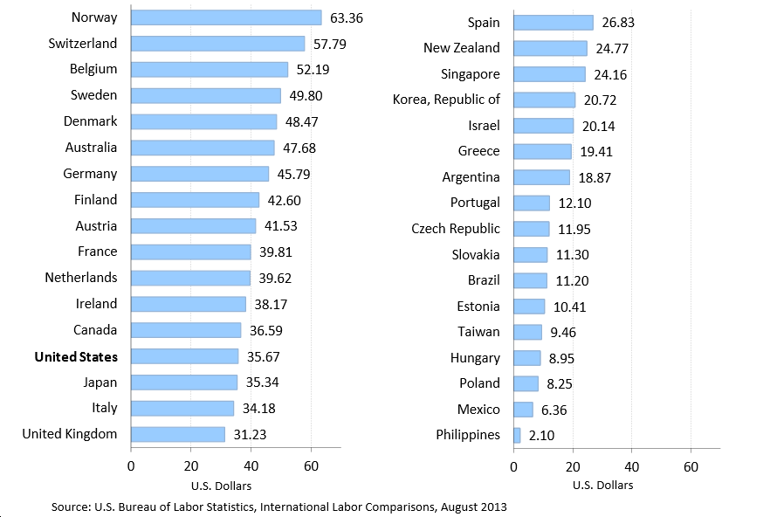
Comparison of 2012 Hourly Wages for Manufacturing Workers
Hong Kong (2015) median = US$7.83
China (2013) = US$4.12

Slide 10
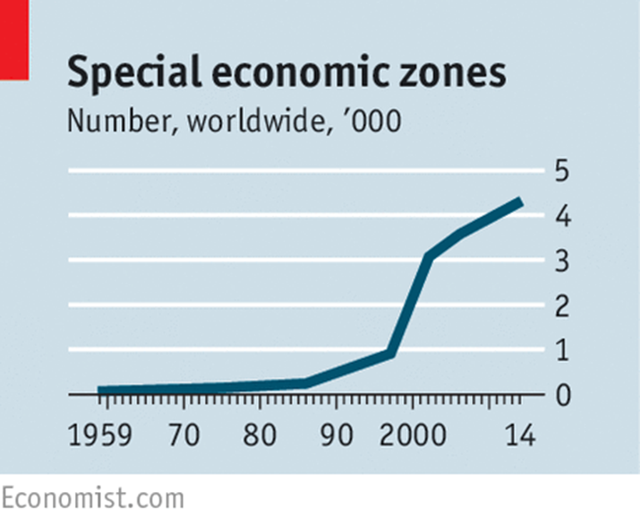
Special economic zones
4,300 SEZs in the world
3 out of 4 countries have at least one
Tax-and-tariff incentives
Streamlined customs procedures
Less regulations
Source: Economist, 4 Apr 2015
Notes:
http://www.economist.com/news/leaders/21647615-world-awash-free-trade-zones-and-their-offshoots-many-are-not-worth-effort-not

Slide 11
Quantitative Location Factors
Exchange Rates
Variations in rates can have a significant effect on sales and profits.
Tax Rates
Taxes vary considerably between countries and within countries.
All forms of taxes should be considered (property, payroll, inventory, and investment taxes).

Slide 12
Profit Tax by Countries
Source: World Bank 2015
News

Slide 13
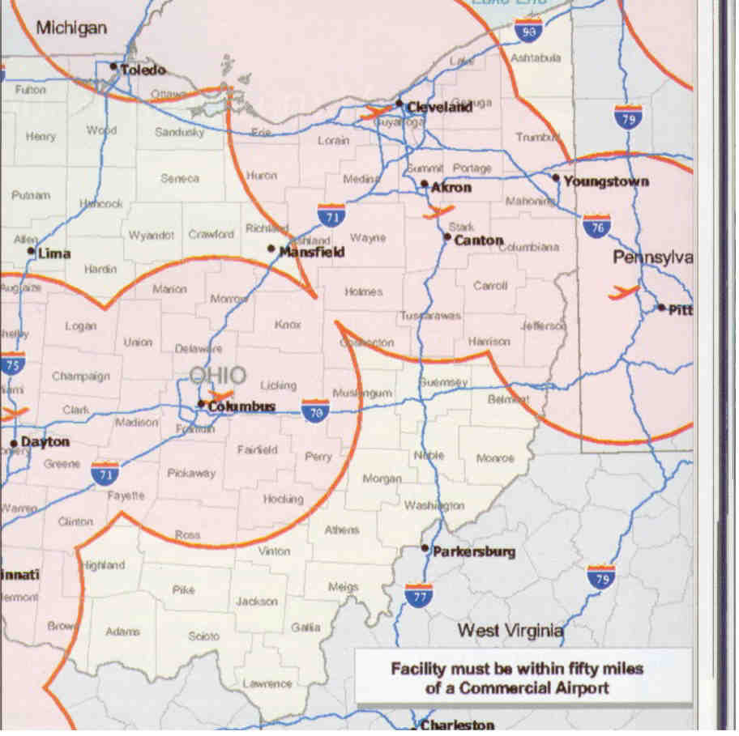
Geographic Information Systems (GIS)
Locating a new power generation facility:
Within 50 miles of a commercial airport.
With more than 5000 workforce.
Within 5 miles of a 230-kVolt transmission line.
Within 5 miles of a 12-inch or larger gas line.

Slide 14
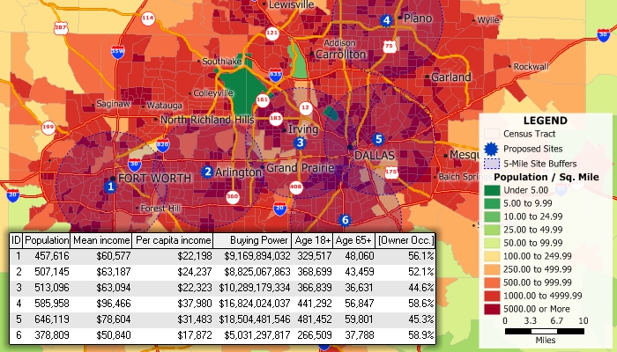
Geographic information systems (GIS)
http://www.caliper.com/Video/maptitude-mapping-software/maptitude-demo/maptitude-mapping-software-demo-video.html

Slide 15
Evaluating Potential Locations
Factor Rating System
Identify the specific criteria or factors to be considered.
Assign a weight to each factor.
Select a common scale for rating each factor.
Rate each potential location on each of the factors.
Multiply each factor’s score by its weight.
Sum the weighted scores and select the location with the highest score.

Slide 16
Factor-Rating System Example
The Low-Credit Card Interest Bank
According to the factor rating system: Site A or Site B should be selected?

Slide 17
Amazon HQ2
https://youtu.be/OJRvUjGY6kc

Slide 18
https://images-na.ssl-images-amazon.com/images/G/01/Anything/test/images/usa/RFP_3._V516043504_.pdf

Slide 19
Amazon HQ2
https://youtu.be/OJRvUjGY6kc

Slide 20
Evaluating Potential Locations (cont’d)
Center of Gravity Method
Used to determine the optimal location of a facility based on minimizing the transportation costs between where the goods are produced and where they are sold or redistributed.
Locate each existing operation on an X and Y coordinate grid map.
Calculate X coordinate of center of gravity
Calculate Y coordinate of center of gravity

Slide 21
Center of Gravity Formulas
C_{x} = X coordinate of the center of gravity C_{y} = Y coordinate of the center of gravity
d_{ix} = X coordinate of the i^{th} location d_{iy} = Y coordinate of the i^{th} location V_{i} = Volume of goods transported to the i^{th} location

Slide 22
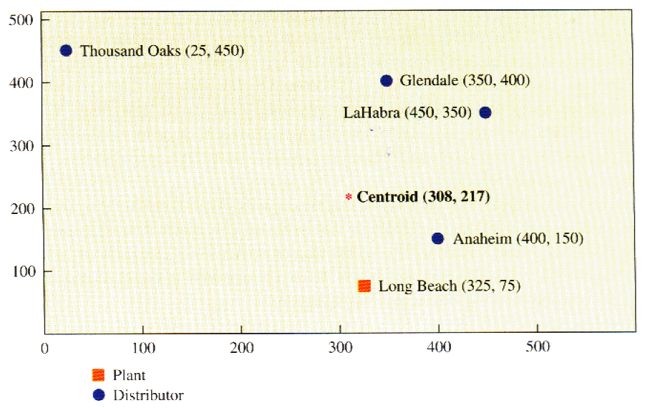
Plant Location Methodology: Example
Centroid method example
The HiOctane Refining Company needs to locate an intermediate holding facility between its refining plant in Long Beach and its major distributors.
Locations
Gallons of Gasoline per Month (000,000)
Long Beach
1500
Anaheim
250
LaHabra
450
Glendale
350
Thousand Oaks
450
Question: What is the best location for the intermediate holding facility considering only distances and quantities shipped per month?

Slide 23
Plant Location Methodology: Example
Determining Existing Facility Coordinates
To begin, you must identify the existing facilities on a two-dimensional plane or grid and determine their coordinates.
Locations
Gallons of Gasoline per Month (000,000)
You must also have the volume information on the business activity at the existing facilities.
Long Beach
1500
Anaheim
250
LaHabra
450
Glendale
350
Thousand Oaks
450

Slide 24
Plant Location Methodology: Example
Determining the Coordinates of the New Facility
You then compute the new coordinates using the formulas:
You then take the coordinates and place them on the map:
New location of facility about (308,217)

Slide 25
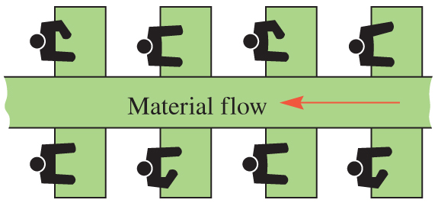
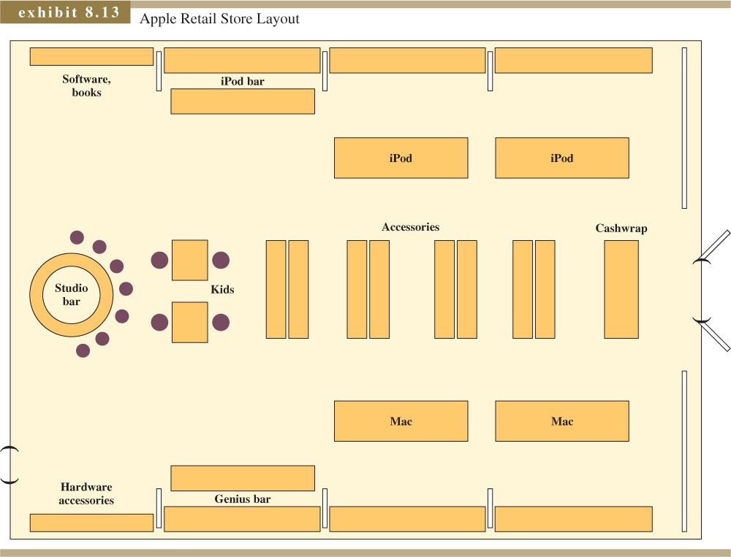
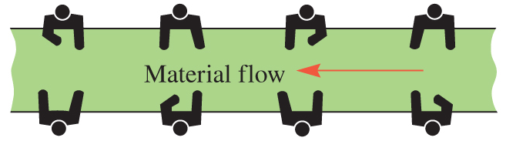
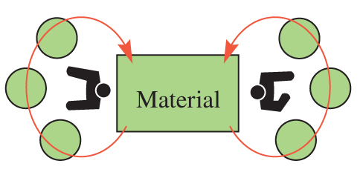
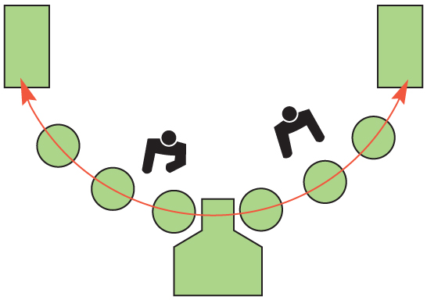
Layout Decisions
Facility layout: the process of determining placement of departments, workgroups within departments, workstations, machines, and stock-holding points within a facility.

Slide 26
Facilities Layout for Services
Goals of Service Facility Layouts
Minimize travel time for workers and customers
Maximize revenues from customers
Types of Service Layouts
Process layout—emergency rooms in a hospital
Product layout—cafeteria line – Delifrance or Canteen
Fixed-position layout—automobile repair shop, operating room in a hospital, table at a restaurant.

Slide 27
Facilities Layout for Services
Servicescape
The aspects of the physical surroundings in a service operation that can affect a customer’s perception of the service received.
Ambient conditions
Noise, lighting, and temperature
Spatial layout and functionality
Minimizing employee and/or customer travel time and maximizing revenue opportunities from customers
Signs, symbols, and artifacts
Objects that create positive images of the firm

Slide 28
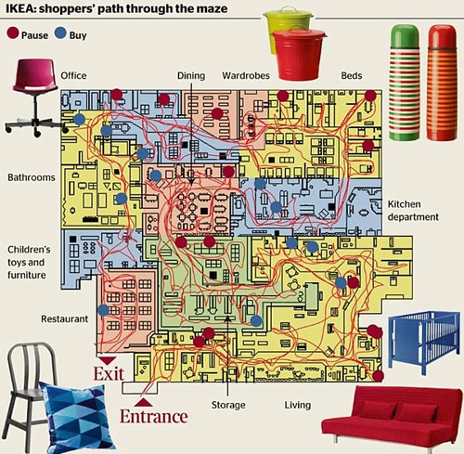
IKEA: https://youtu.be/-HmFMcZv2xE

Slide 29
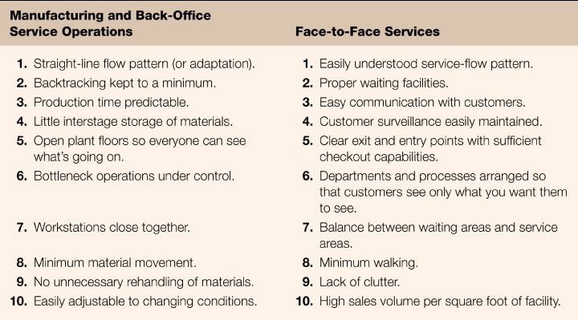
Characteristics of a Good Layout
Exhibit 12.1

Slide 30
Learning Outcomes
Lecture outline II
Construct layout plans by systematic layout planning approach.
References: Jacobs & Chase, 15th ed, Chapters 8, 15.

Slide 31
Facility Layout – Systematic Layout Planning Approach
Definition
Select the most effective physical arrangement of facilities to produce products or provide services.
Objectives
The ultimate goal is building a plant to achieve the overall business plan: the type of product to be produced in the plant and the rate of production

Slide 32
Systematic Layout Planning Approach
In achieving the goal, the following objectives should be considered:
Minimize investment in equipment
Minimize overall production time
Utilize existing space most effectively
Provide for employee convenience, safety, and comfort
Maintain flexibility of arrangement and operation
Minimize material handling cost

Slide 33
Systematic Layout Planning Processes (SLP)

Slide 34
Activity Relationship Analysis
The placement of the departments in a plant layout is very much dependent on the relationships of their activities.
Activity relationship chart shows the importance of relationship between any pair of activities, in terms of material flow, information flow, people’s move, convenience, etc.. The more important a relationship between two activities, the closer should these two activities in the layout. The figure on the left shows the format of an activity relationship chart of 10 departments. The departments (activities) are listed on the left in the chart, one in each row. The intersection blocks on the right are for importance codes for the relationships among the activities.

Slide 35
Activity Relationship Analysis
Activity relationship chart
The relationship importance are classified into 6 categories
Code | Definition
“A” | Absolutely necessary to be next to each other
“E” | Especially important
“I” | Important
“O” | Ordinary Important
“U” | Unimportant
“X” | Closeness undesirable
Construct the activity relationship chart:
Fill in the importance code in each block according to the importance of the relationship between the two activities.
Guideline:
No more than 5% of the relationships should be assigned “A” or “X”;
No more than 10% “E”;
No more than 15% “I”;
No more than 20% “O”.

Slide 36
Activity Relationship Analysis - Example
Reason Code
Code | Reason
1 2 3 4 5 … | Material flow Ease of supervision Common personnel Contact necessary Convenience …
To include more information in the chart, the reasons for assigning the importance codes may be presented on the chart by putting a reason code under each importance code. In this case, a table showing the definition of these reason code should be attached to the chart. Here is the activity relationship chart of the above example. Reason codes are only listed for a few relationships for example purpose.

Slide 37
Dimensionless Block Diagram
Dimensionless block diagram shows a dimensionless layout based on the activity relationship information
Procedure for constructing dimensionless block diagram (unit block layout)
Step 1: Preparation:
This procedure uses equal sized square blocks to represent the departments (activities) and place them to the layout one by one until all the departments have been placed. In each iteration of the procedure we need to make the following two decisions.
The order of placing the departments (which department should be placed to the layout next).
The relative positions between the department being placed and the departments already on the layout (where it should be placed).

Slide 38
Dimensionless Block Diagram
Step 2: Preparation
In this method, both of these two decisions are made based on the total closeness ratings of the departments. The total closeness rating of a department can be calculated as follows:
Since the types of relationships (A, E, I, O, U, X) defines how close the departments should be, we assign the closeness rating to the different types of relationship as follows:
A = 10,000, E = 1,000,
I = 100, O = 10,
U = 1, X = -10,000.
Then, the total closeness rating (TCR) of a department is the sum of the absolute values for all the relationships between this department and other departments.

Slide 39
Dimensionless Block Diagram
Step 2: Preparation
The TCRs can be calculated in a table form. The table below shows the calculation for the example problem.
 | Department |  |  |  |  |  |  |  |  |  | Summary
Dept. | 1 | 2 | 3 | 4 | 5 | 6 | 7 | 8 | 9 | 10 | A | E | I | O | U | X | TCR
1 | - | I | U | U | U | U | U | I | U | A | 1 | 0 | 2 | 0 | 6 | 0 | 10206
2 | I | - | O | E | E | A | A | I | E | I | 2 | 3 | 3 | 1 | 0 | 0 | 23310
3 | U | O | - | U | U | A | A | U | U | X | 2 | 0 | 0 | 1 | 5 | 1 | 30015
4 | U | E | U | - | A | U | U | U | U | U | 1 | 1 | 0 | 0 | 7 | 0 | 11007
5 | U | E | U | A | - | U | U | O | O | U | 1 | 1 | 0 | 2 | 5 | 0 | 11025
6 | U | A | A | U | U | - | I | U | U | U | 2 | 0 | 1 | 0 | 6 | 0 | 20106
7 | U | A | A | U | U | I | - | U | U | X | 2 | 0 | 1 | 0 | 5 | 1 | 30105
8 | I | I | U | U | O | U | U | - | I | U | 0 | 0 | 3 | 1 | 5 | 0 | 315
9 | U | E | U | U | O | U | U | I | - | E | 0 | 2 | 1 | 1 | 5 | 0 | 2115
10 | A | I | X | U | U | U | X | U | E | - | 1 | 1 | 1 | 0 | 4 | 2 | 31104

Slide 40
Dimensionless Block Diagram
The procedure
Step 0. Select the department with the highest TCR value and place it in the middle of the layout. Mark “last to place” to those departments having an X relation with this department.
Step 1. From the remaining departments which have an A relation with any of the placed departments, select the one with the highest TCR value (those marked “last to place” have the lowest priority even if their TCRs are higher). If no remaining department has an A relation with the placed departments, then select from those having an E relation with the placed departments, and so on.
Mark “last to place” to those departments having an X relation with the selected department.

Slide 41
Dimensionless Block Diagram
Step 2. Number the positions around the placed departments anti-clockwise starting from the left side of the most left-upper placed department, see the example below. Place the selected department into one of the numbered positions so that its weighted placement value will be maximized. If ties exist, place it into the position with smaller number.
The weighted placement value: When the department in a position,
For each placed departments having side touch with it, assign a value according to their relation: A = 10,000; E = 1,000; I = 100; O = 10; U = 1; X = -10,000;
For each placed departments having corner touch with it, assign a value according to their relation: A = 5,000; E = 500; I = 50; O = 5; U = 0.5; X = -5,000;
The weighted placement value of the department is then the sum of the values for all the placed departments touching with it.
Step 3. If all the departments have been placed, STOP! Otherwise, go to Step 1.

Slide 42
Example
8
7
6
10
9
8
7
1
10
5
➔
1
1
10
6
2
3
4
2
3
4
5
Declare Dept. 7 and Dept. 3 are the 2nd last and last departments to be placed respectively
➔
12
11
10
9
12
11
10
9
1
1
10
8
1
1
10
8
➔
2
3
9
7
2
2
9
7
4
5
6
3
4
5
6

Slide 43
Example (cont.)
12
11
10
9
14
13
12
11
14
13
1
10
8
16
15
1
10
10
➔
6
2
9
➔
6
2
9
1
7
1
9
2
3
4
5
6
2
3
5
7
8
4
5
6
➔
14
13
12
11
14
13
12
11
16
15
1
10
10
16
15
1
10
10
1
6
2
9
9
➔
1
6
2
9
9
2
4
5
7
8
2
4
5
8
8
3
4
5
6
3
4
5
6
7

Slide 44
Example – Completed dimensionless block diagram
16
15
14
13
12
1
7
1
10
11
7
1
10
➔
2
6
2
9
10
➔
3
6
2
9
3
4
5
8
9
4
5
8
4
5
6
7
8
All the departments have been placed now,
the Dimensionless Block Diagram is completed

Slide 45
Space Relationship Diagram
Combine the space consideration with the REL diagram.
Replace the unit squares of the dimensionless block diagram with space templates.
Construct different space relationship diagrams from the same REL diagram.
Number | Department name | Area (ft²) | Number of unit squares | Template dimensions
1 2 3 4 5 6 7 8 9 10 | Offices Foreman Conference room Parcel post Parts shipment Repair and service parts Service area Receiving Testing General storage | 1200 150 300 400 600 300 900 600 1000 3000 8450 ft² | 48 6 12 16 24 12 36 24 40 120 338 | 6 x 8 2 x 3 3 x 4 4 x 4 4 x 6 3 x 4 6 x 6 4 x 6 5 x 8 10 x 12
Scale: 1 unit square = 5 ft x 5 ft = 25 ft²

Slide 46
Space Relationship Diagram

Slide 47
Alternative block plans

Slide 48
The End
Thank You

